Slide 1
Competitive Programming
03 Feb. 2023
Andrei Novikov

Slide 2
Linear Data Structure and Built-In Libraries
A data structure is classified as a linear data structure if its elements form a linear sequence, i.e. its elements are arranged from left to right (or top to bottom).
Mastery of these basic linear data structures below is critical in today’s programming contests
It is appropriate to discuss two operations commonly performed on Arrays: Sorting and Searching.

Slide 3
Quiz 1
Obtain the remainder (modulo) of S when it is divided by N (N is a power of 2) e.g. S = (7)₁₀ % (4)₁₀ = (111)₂ % (100)₂ = (11)₂ = (3)₁₀.

Slide 4
Quiz 1
Obtain the remainder (modulo) of S when it is divided by N (N is a power of 2) e.g. S = (7)₁₀ % (4)₁₀ = (111)₂ % (100)₂ = (11)₂ = (3)₁₀.
Complexity: O(1). Formula: Modulo(S) = S & (D – 1)
6(110) % 4(100) = 110 & (100 – 1) = 110 & 011 = 010
12(1100) % 8(1000) = 1100 & 0111 = 100
10(1010) % 2(10) = 1010 & 0001 = 0

Slide 5
Quiz 2
Determine if S is a power of 2.
S = (7)₁₀ = (111)₂ is not a power of 2, but (8)₁₀ = (100)₂ is a power of 2.

Slide 6
Quiz 2
Determine if S is a power of 2.
S = (7)₁₀ = (111)₂ is not a power of 2, but (8)₁₀ = (100)₂ is a power of 2.
Complexity: O(1). Formula: S & (S – 1) == 0 ? True : False
7: 111 & 110 = 110 => False
12: 1100 & 1001 = 1000 => False
8: 1000 & 0111 = 0 => True
16: 10000 & 01111 = 0 => True

Slide 7
Quiz 3
Turn off the last bit in S
S = (40)₁₀ = (101000)₂ → S = (32)₁₀ = (100000)₂.

Slide 8
Quiz 3
Turn off the last bit in S
S = (40)₁₀ = (101000)₂ → S = (32)₁₀ = (100000)₂.
Complexity: O(1). Formula: S & (S – 1)
40: 101000 & 100111 = 100000
12: 1100 & 1001 = 1000
13: 1101 & 1100 = 1100

Slide 9
Quiz 4
Turn on the last zero in S
S = (41)₁₀ = (101001)₂ → S = (43)₁₀ = (101011)₂.

Slide 10
Quiz 4
Turn on the last zero in S
S = (41)₁₀ = (101001)₂ → S = (43)₁₀ = (101011)₂.
Complexity: O(1). Formula: S | (S + 1)
41: 101001 | 101010 = 101011
12: 1100 | 1101 = 1101
13: 1101 | 1110 = 1111

Slide 11
Quiz 5
Turn off the last consecutive run of ones in S
S = (39)₁₀ = (100111)₂ → S = (32)₁₀ = (100000)₂.

Slide 12
Quiz 5
Turn off the last consecutive run of ones in S
S = (39)₁₀ = (100111)₂ → S = (32)₁₀ = (100000)₂.
Complexity: O(N).
turned = orig + 1;
while (orig & turned == orig) {
turned++;
}
39: 100111 & 101000 = 100000 => Stop
46: 101110 & 101111 = 101110 => Continue
101110 & 110000 = 100000 => Stop

Slide 13
Quiz 5
Turn off the last consecutive run of ones in S
S = (39)₁₀ = (100111)₂ → S = (32)₁₀ = (100000)₂.
Complexity: O(N).
mask = 1
while (mask ^ orig == 1) {
mask <<= 1
}
while (mark ^ orig != 1) {
orig &= orig - 1
mask <<= 1;
}
return orig

Slide 14
Quiz 6
Turn on the last consecutive run of zeroes in S
S = (36)₁₀ = (100100)₂ → S = (39)₁₀ = (100111)₂.

Slide 15
Quiz 6
Turn on the last consecutive run of zeroes in S
S = (36)₁₀ = (100100)₂ → S = (39)₁₀ = (100111)₂.
Complexity: O(N).
mask = 1
while (mask ^ orig != 0) {
mask <<= 1
}
while (mark ^ orig == 1) {
orig |= mask;
mask <<= 1;
}
return orig

Slide 16
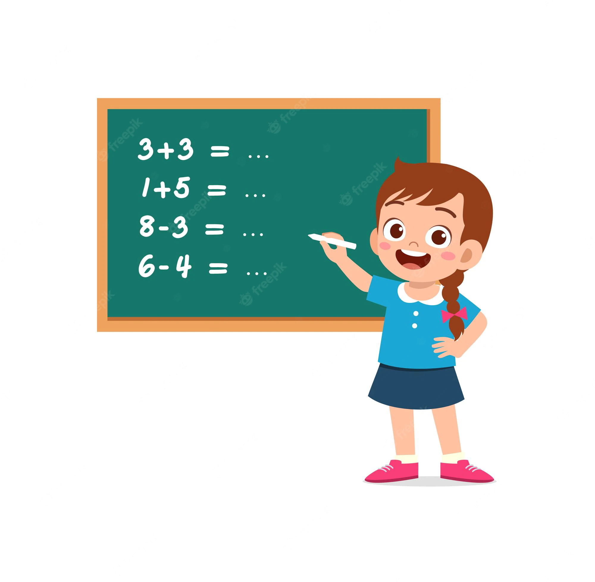
Practice – Challenge #1
Resource: LeetCode
136. Single Number - Link

Slide 17
Practice – Challenge #2
Resource: LeetCode
67. Add Binary - Link

Slide 18
Hometask
Resource: Competitive Programming 3:
Chapter 2.2. Linear DS with Built-in Libraries
UVa 00230 – Borrowers
UVa 00394 – Mapmaker
UVa 00414 – Machined Surfaces

Slide 19




Where to Practice
LeetCode [link]
HackerRank [link]
Kattis [link]
TopCoder [link]
Other Resources

